Slide 1
HealthCare Internet
Krunal Nisar
001715099

Slide 2
Patients Global History Retrieval
Global Searching of the patients
Local searching of the patients within country.
Retrieving patient history and treating a patient at any corner of the world and storing the history with its primary doctor is most important use case.

Slide 3
False Prescriptions Avoided
FDA has list of approved drugs.
Pharmacy and Doctor can only see drugs which are approved from FDA.

Slide 4
Mitigate Adverse Events
Patients ➔ Feedback ➔ SideEffects ➔ Doctor.
Doctor ➔ Analyze case of Patient ➔ Report to FDA➔ Medicines
FDA ➔ Add ➔ Medicine ➔ Suspicious List of Medicine.
Repeatedly cases ➔ Identify ineffective Drug ➔ Report Manufacture.

Slide 5
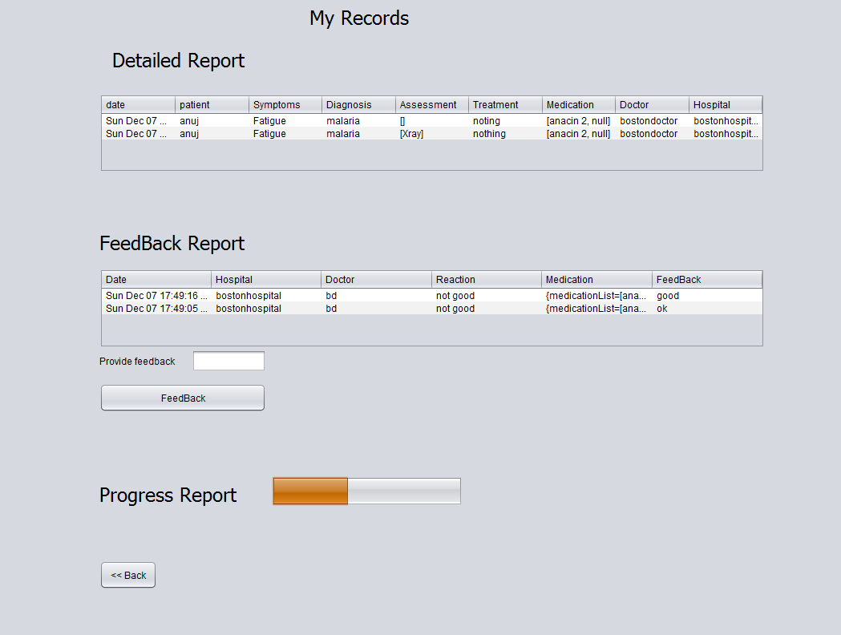
Doctors Online feedback
Doctors feedback through online communication helps doctor and patients to communication better and in efficient way.
Visits are reduced.
Faster Communication
Eg)Diabetis

Slide 6
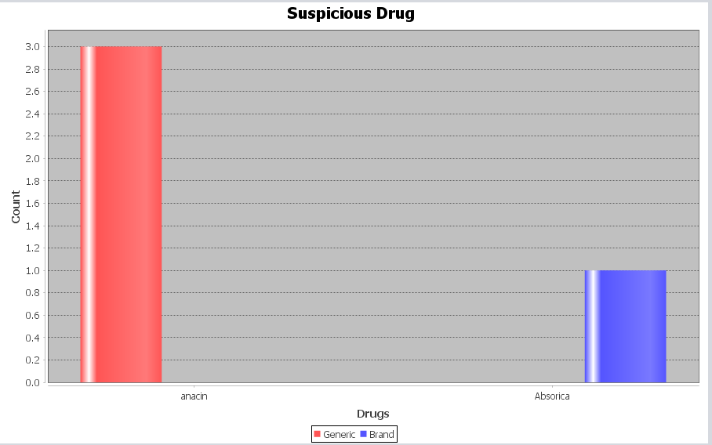
Generic vs Branded Drugs

Slide 7
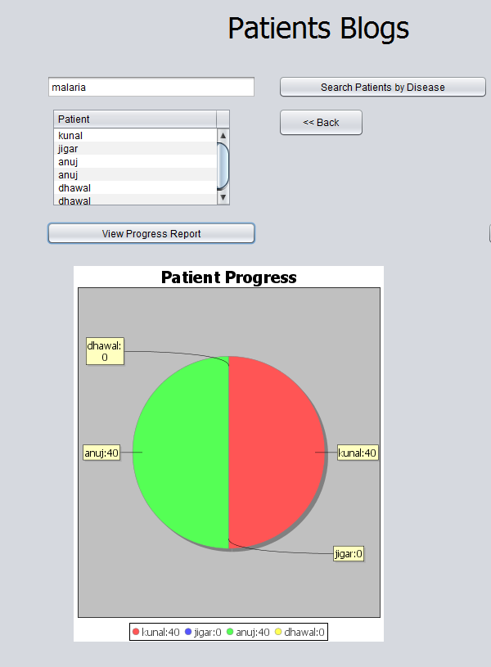
Patients Portal
Patients can search patients like them by searching through their diagnosis.
Patient can view others progress provided by doctor.

Slide 8
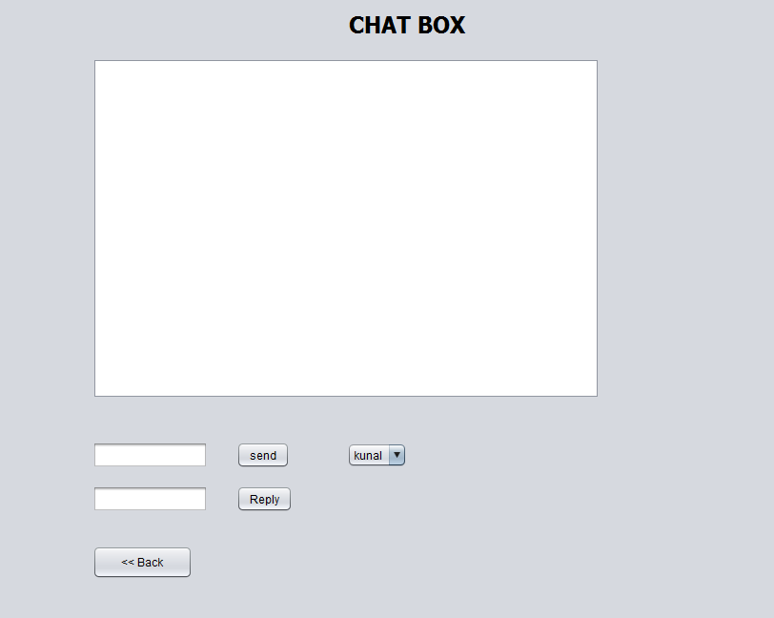
Patient Chat Box
Patients are able to communicate which each other and share their experience

Slide 9
Patient Safety
Suspecting the drug with side effects and making a call back product is case of adverse events and enhance patients safety.

